Slide 1

PASHUMITRA AI
LIVESTOCK HEALTH TRIAGE CHATBOT FOR RURAL FARMERS
PAVAN NAGESH | SANJANA SHETTI | RAKSHITA G |
ROHAN KABADI

Slide 2
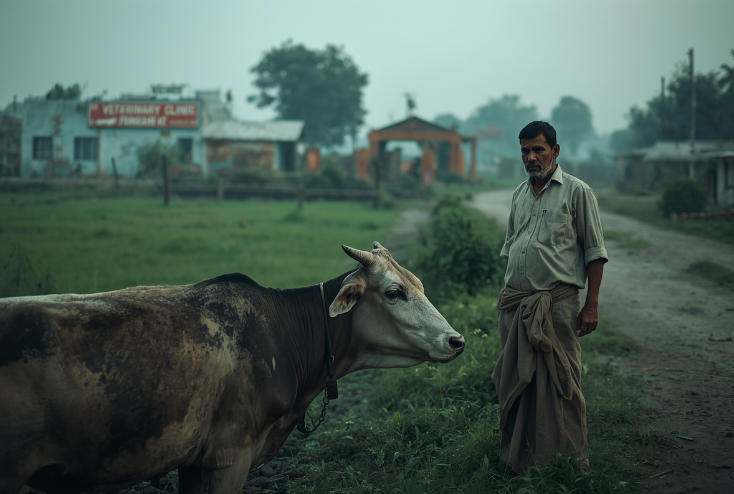
PROBLEM STATEMENT
Develop a multilingual AI-powered livestock health triage chatbot that helps rural farmers identify probable animal diseases from symptoms, provides first-aid guidance, classifies case severity, and generates veterinary alert messages for timely intervention.

Slide 3
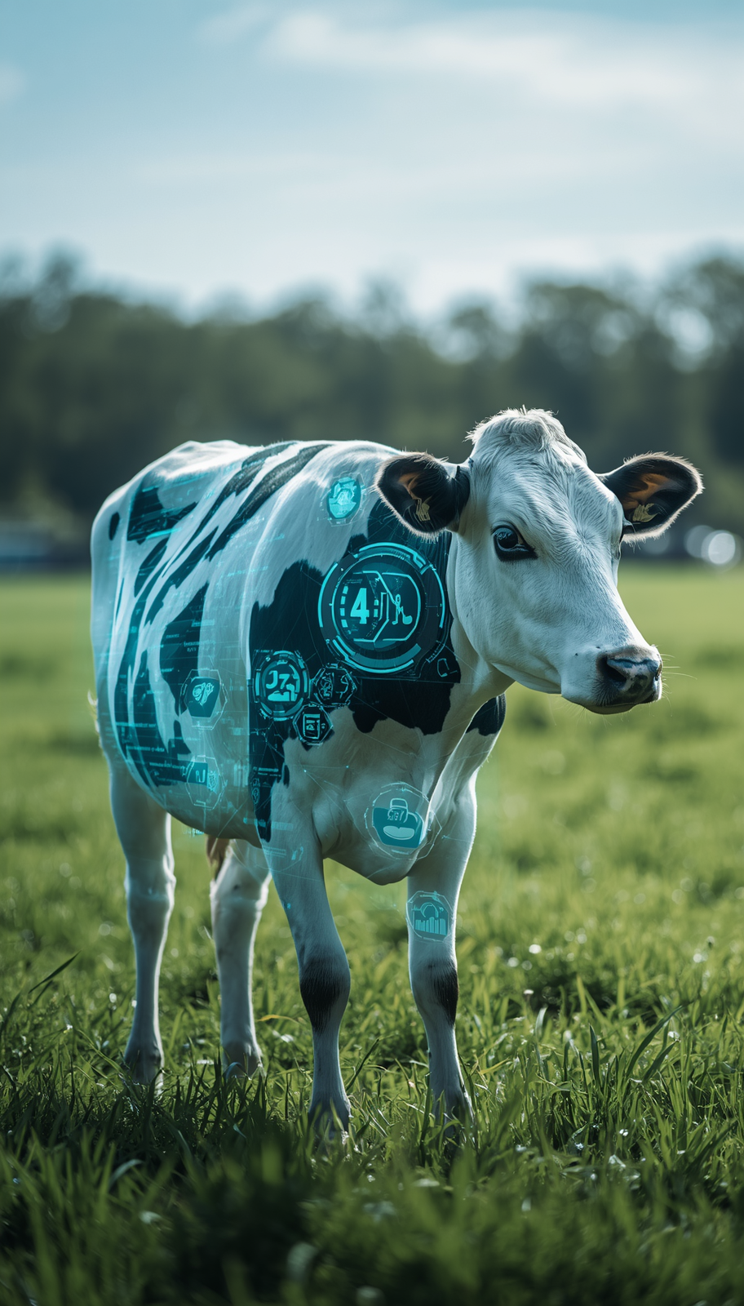

PROJECT OBJECTIVES
PASHUMITRA AI
CLEAR GOALS DRIVING LIVESTOCK HEALTH INNOVATION
MULTILINGUAL SYMPTOM REPORTING
DISEASE PREDICTION & TRIAGE
FIRST-AID & VET ALERTS
ENABLE FARMERS TO REPORT LIVESTOCK SYMPTOMS IN THEIR NATIVE LANGUAGE THROUGH VOICE OR TEXT INPUT FOR ACCESSIBLE HEALTHCARE.
AI-POWERED DISEASE IDENTIFICATION WITH URGENCY CLASSIFICATION TO PRIORITIZE CASES AS SELF-TREATABLE, URGENT, OR CRITICAL.
PROVIDE IMMEDIATE FIRST-AID GUIDANCE AND AUTOMATICALLY GENERATE SMS ALERTS TO NEARBY VETERINARIANS FOR TIMELY INTERVENTION.

Slide 4
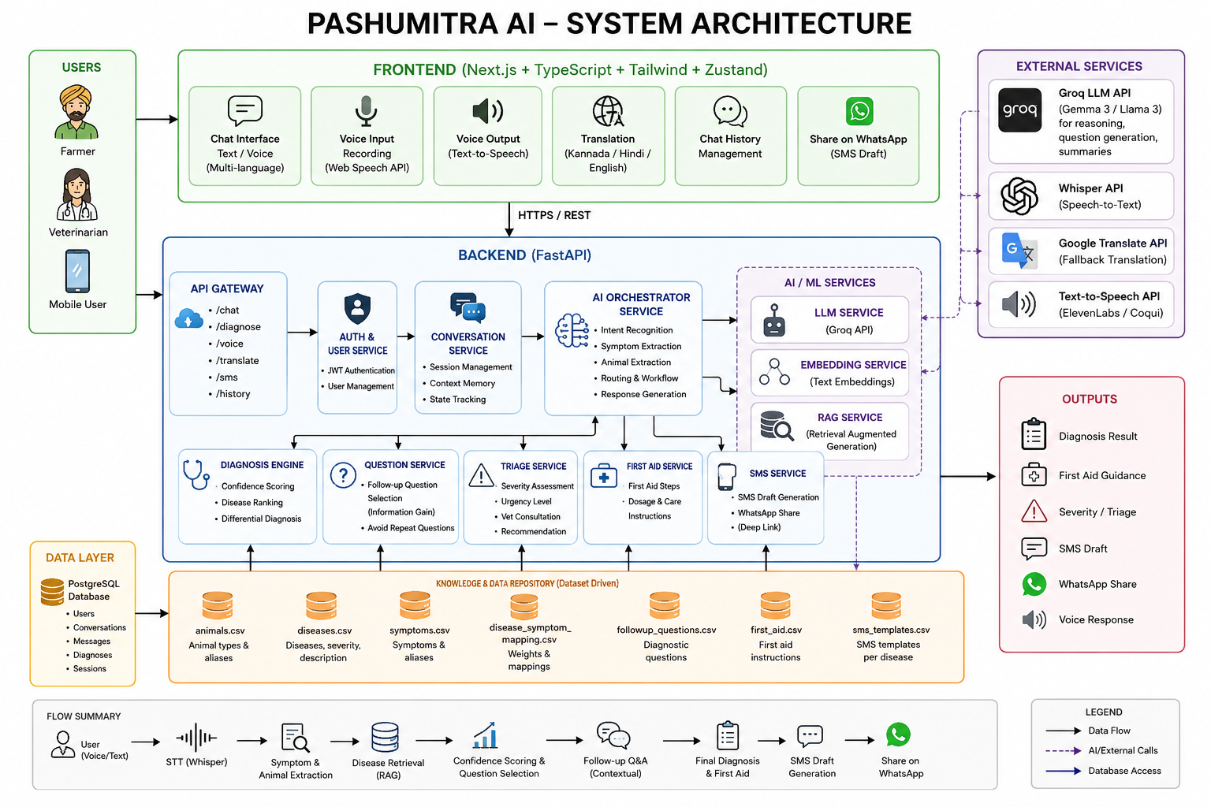

Slide 5

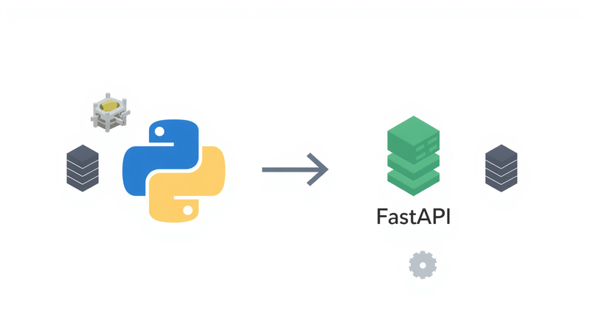

TECHNOLOGY STACK
LAYERED ARCHITECTURE FOR SCALABLE LIVESTOCK HEALTH TRIAGE
AI & VOICE PROCESSING
BACKEND SERVICES
GROQ API WITH LLAMA MODELS FOR DIAGNOSIS, FASTER-WHISPER FOR VOICE INPUT, AND TRANSLATION SERVICES.
FRONTEND LAYER
FASTAPI WITH PYTHON ENABLES FAST, RELIABLE API ENDPOINTS FOR CHATBOT SERVICES.
NEXT.JS 15 AND REACT 19 POWER THE RESPONSIVE USER INTERFACE FOR FARMERS.
PASHUMITRA AI

Slide 6

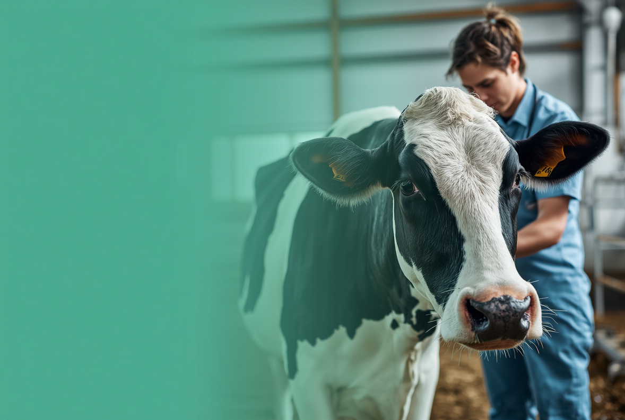
DATASET SOURCES
POWERING ACCURATE LIVESTOCK DIAGNOSIS
NADIS DATABASE
COMPREHENSIVE UK LIVESTOCK DISEASE DATABASE PROVIDING DETAILED SYMPTOM PROFILES AND TREATMENT PROTOCOLS FOR CATTLE, SHEEP, AND PIGS.
VETCOMPASS CLINICAL DATA
ICAR-NIVEDI
INDIAN COUNCIL OF AGRICULTURAL RESEARCH DISEASE SURVEILLANCE DATA COVERING REGIONAL LIVESTOCK HEALTH PATTERNS AND OUTBREAK MONITORING.
FAO EMPRES-I
GLOBAL ANIMAL DISEASE INFORMATION SYSTEM TRACKING TRANSBOUNDARY DISEASE EVENTS AND EARLY WARNING ALERTS.

Slide 7
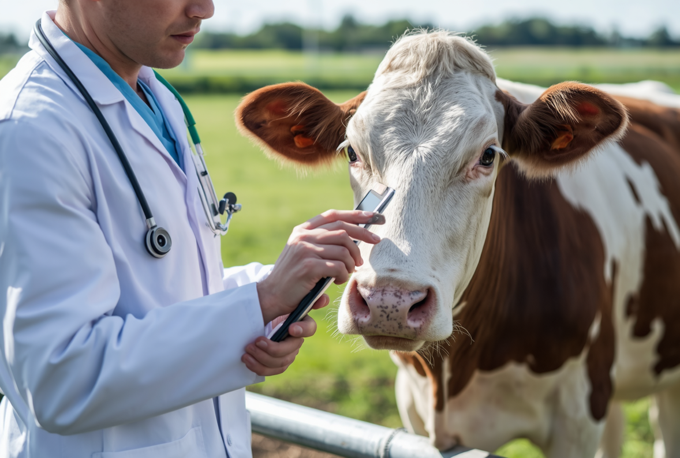
KEY CAPABILITIES OF PASHUMITRA AI CHATBOT SYSTEM
SYMPTOM EXTRACTION
AI-POWERED NATURAL LANGUAGE PROCESSING IDENTIFIES AND EXTRACTS LIVESTOCK SYMPTOMS FROM FARMER CONVERSATIONS IN REAL-TIME.
PASHUMITRA AI
DISEASE PREDICTION
MACHINE LEARNING ALGORITHMS ANALYZE SYMPTOMS AGAINST COMPREHENSIVE DISEASE DATABASES TO PREDICT POTENTIAL CONDITIONS ACCURATELY.
CONFIDENCE SCORING
EACH DIAGNOSIS INCLUDES RELIABILITY SCORES HELPING FARMERS AND VETS UNDERSTAND PREDICTION CERTAINTY LEVELS.
CORE FEATURES
MULTILINGUAL & SMS ALERTS
KANNADA LANGUAGE SUPPORT WITH AUTOMATIC SMS ALERTS TO VETERINARIANS FOR URGENT CASES.

Slide 8
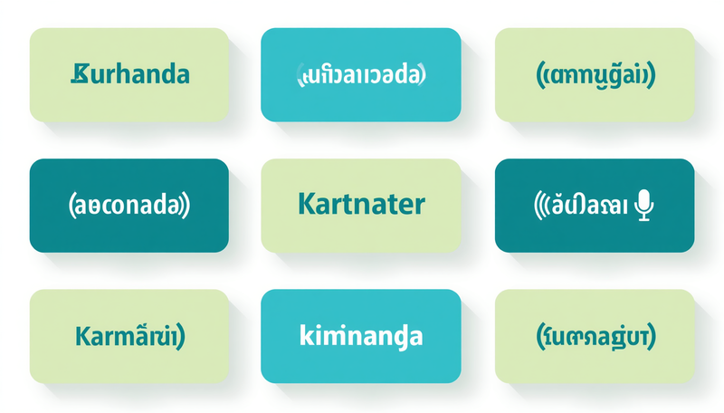

MULTILINGUAL & VOICE SUPPORT
KANNADA SUPPORT
FULL KANNADA LANGUAGE SUPPORT WITH REAL-TIME TRANSLATION SERVICES FOR SEAMLESS FARMER COMMUNICATION.
PASHUMITRA AI
VOICE RECOGNITION
VOICE-TO-TEXT TRANSCRIPTION POWERED BY SARVAM API ENABLES HANDS-FREE SYMPTOM REPORTING.
CONVERSATIONAL UI
FARMER-FRIENDLY CHAT INTERFACE DESIGNED FOR EASE OF USE WITH MINIMAL TECHNICAL KNOWLEDGE REQUIRED.

Slide 9
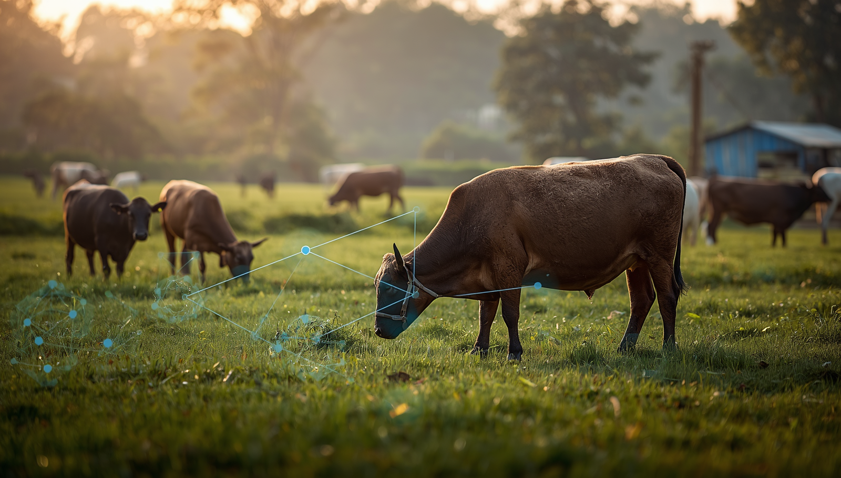
THANK YOU!
QUESTIONS WELCOME
PASHUMITRA AI – EMPOWERING RURAL FARMERS WITH AI-DRIVEN LIVESTOCK HEALTHCARE.

